Slide 1
Programmable Interfacing Devices

Slide 2
General-Purpose Programmable Peripheral Devices
PPI – Programmable Peripheral Interface
It is an I/O port chip used for interfacing I/O devices with microprocessor.
Very commonly used programmable devices from Intel family are:
The 82C55 peripheral interface.
The 8254 Interval Timer.
The 8294A Interrupt Controller.
The 8237 DMA controller.

Slide 3
82C55 Programmable Peripheral Interface
The 82C55 is a general purpose programmable I/O device designed to transfer the data from I/O to interrupt I/O under certain conditions as required. It can be used with almost any microprocessor.
It consists of three 8-bit bidirectional I/O ports (24 I/O lines) which can be configured as per the requirement.

Slide 4
82C55 Programmable Peripheral Interface
Features –
It has 24 pins for I/O that are programmable in groups of 12 pins.
Three I/O ports, each port is of 8 bit.
Operate in three distinct modes of operation.
- Simple I/O mode
- Handshake I/O mode
- Bidirectional Handshake I/O mode
Allows dynamic configuration of ports and modes using a control word register.

Slide 5
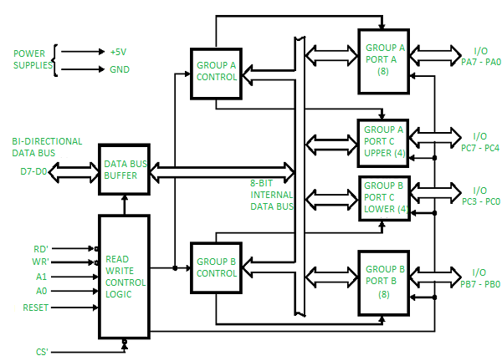
82C55 PPI Block Diagram

Slide 6
82C55 PPI
2 operating modes –
BSR (bit set reset) Mode
Input-Output Mode
Depending upon the value if CS', A1 and A0 we can select different ports in different modes as input-output mode or BSR. This is done by writing a suitable word in control register (control word D0-D7).
CS' | A1 | A0 | Selection | Address
0 | 0 | 0 | PORT A | 80 H
0 | 0 | 1 | PORT B | 81 H
0 | 1 | 0 | PORT C | 82 H
0 | 1 | 1 | Control Register | 83 H
1 | X | X | No Seletion | X

Slide 7
82C55 PPI
Operating Modes – It depends on Control Word (D₀-D₇).
Bit set reset (BSR) mode - If MSB of control word (D7) is 0, PPI works in BSR mode. In this mode only port C bits are used for set or reset.
Input-Output mode - If MSB of control word (D7) is 1, PPI works in input-output mode. This is further divided into three modes:
Mode – 0
Mode – 1
Mode – 2

Slide 8
Different Mode of Operation of 8255
Mode 0 −
In this mode, Port A and B is used as two 8-bit ports and Port C as two 4-bit ports. Each port can be programmed in either input mode or output mode where outputs are latched and inputs are not latched. Ports do not have interrupt capability.
Ex – Turning on/off LEDs, reading simple digital inputs like switches.
Mode 1(Handshake I/O mode or strobed I/O mode) –
In this mode either port A or port B can work as simple input port or simple output port, and port C bits are used for handshake signals before actual data transmission. It has interrupt handling capacity and input and output are latched.PortC Provides handshaking signals for synchronized data transfer between peripheral and 8255
Ex–Communication with keyboards, ADCs, printers.

Slide 9
Different Mode of Operation of 8255
Mode 2 −
Used when data needs to be both sent and received using the same port. In this mode, Port A can be configured as the bidirectional port and Port B either in Mode 0 or Mode 1. Port A uses five signals from Port C as handshake signals for data transfer. The remaining three signals from Port C can be used either as simple I/O or as handshake for port B.
Ex – Interfacing with another microprocessor or microcontroller, such as in multiprocessor systems.

Slide 10
Ports of 8255A
8255A has three ports, i.e., PORT A, PORT B, and PORT C.
Port A contains one 8-bit output latch/buffer and one 8-bit input buffer. Port A can work either in mode 0, mode 1 or mode 2 of input-output mode.
Port B is similar to PORT A. Port B can work in either mode 0 or in mode 1.
Port C can be split into two parts, i.e. PORT C lower (PC0-PC3) and PORT C upper (PC7-PC4) by the control word. Port C can work in either BSR (bit set rest) mode or in mode 0 of input-output mode.

Slide 11
Command Registers
The 82C55 is programmed through the two internal command registers.
Bit position 7 selects either command byte A or command byte B.
Command byte A programs the function of group A and B, whereas command byte B sets (1) or resets (0) bits of port C only if the 82C55 is programmed in mode 1 or 2.

Slide 12
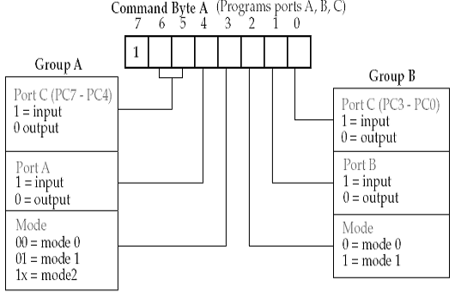
Command Byte A

Slide 13
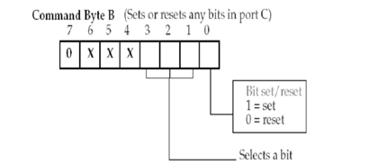
Command Byte B
Selects a bit Of port C
(PC₀ – PC₇)

Slide 14
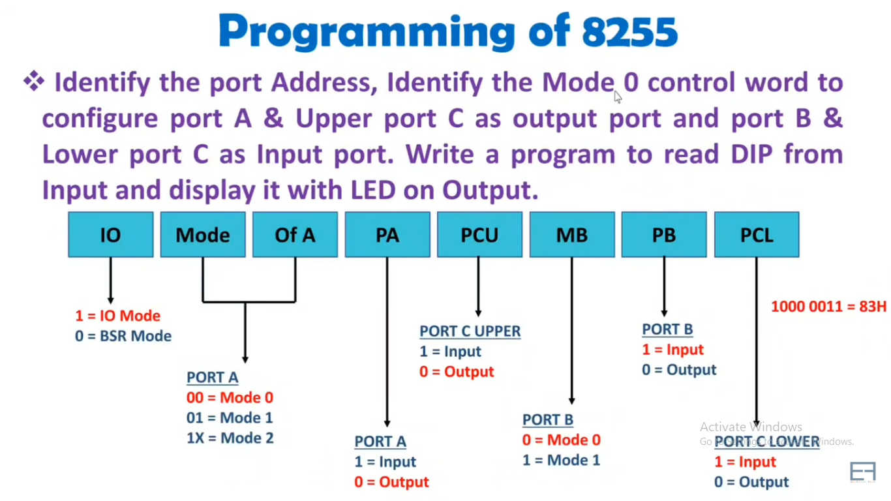
Problem
Control word for the problem below:

Slide 15
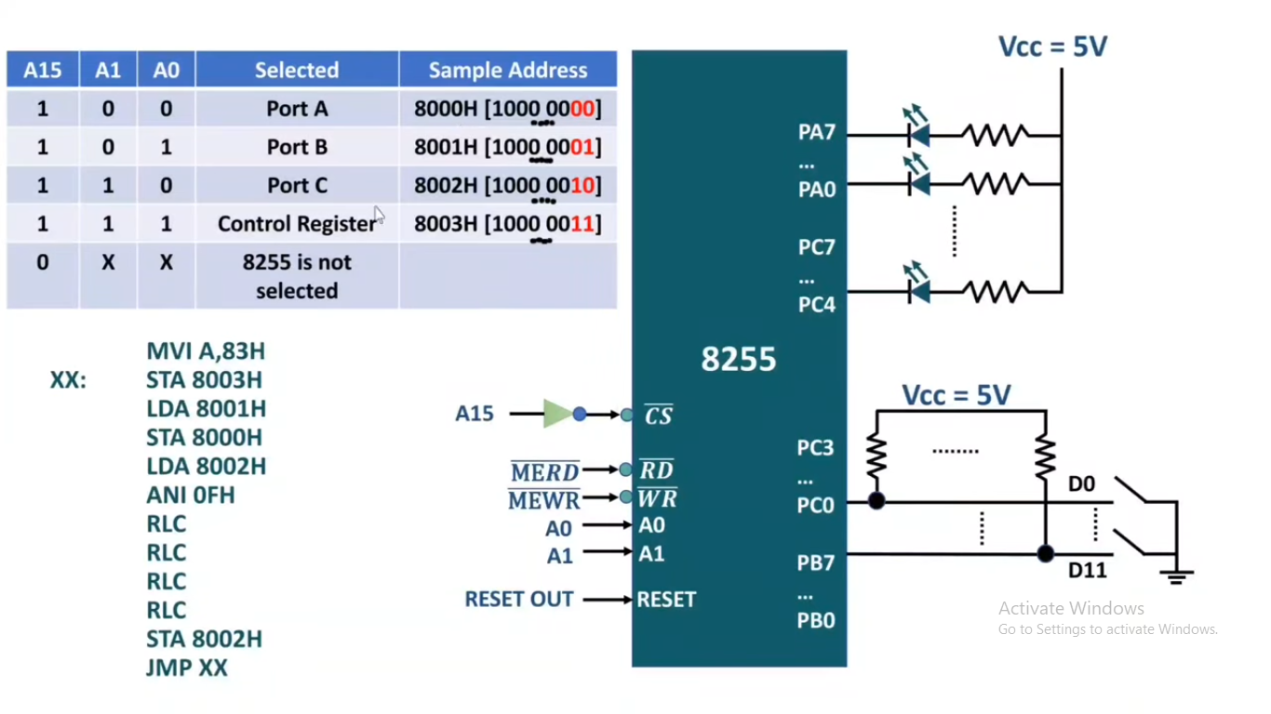
Interfacing, and Addressing Details
MVI=Move immediately, ANI=AND Immediate, RLC=Rotate Left through Carry (Convert lower to upper nibble)

Slide 16
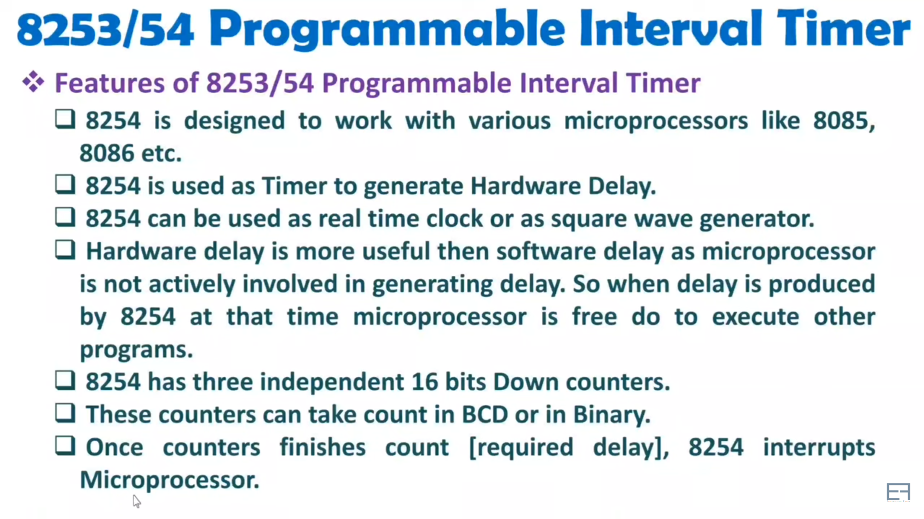

Slide 17
8253 Programmable Interval Timer
The Intel 8253 is Programmable Interval Timers (PTIs) designed for microprocessors to perform timing and counting functions using three 16-bit registers.
Each counter has 2 input pins, i.e. Clock & Gate, and 1 pin for “OUT” output.
To operate a counter, a 16-bit count is loaded in its register.
On command, it begins to decrement the count until it reaches 0, then it generates a pulse that can be used to interrupt the CPU.

Slide 18
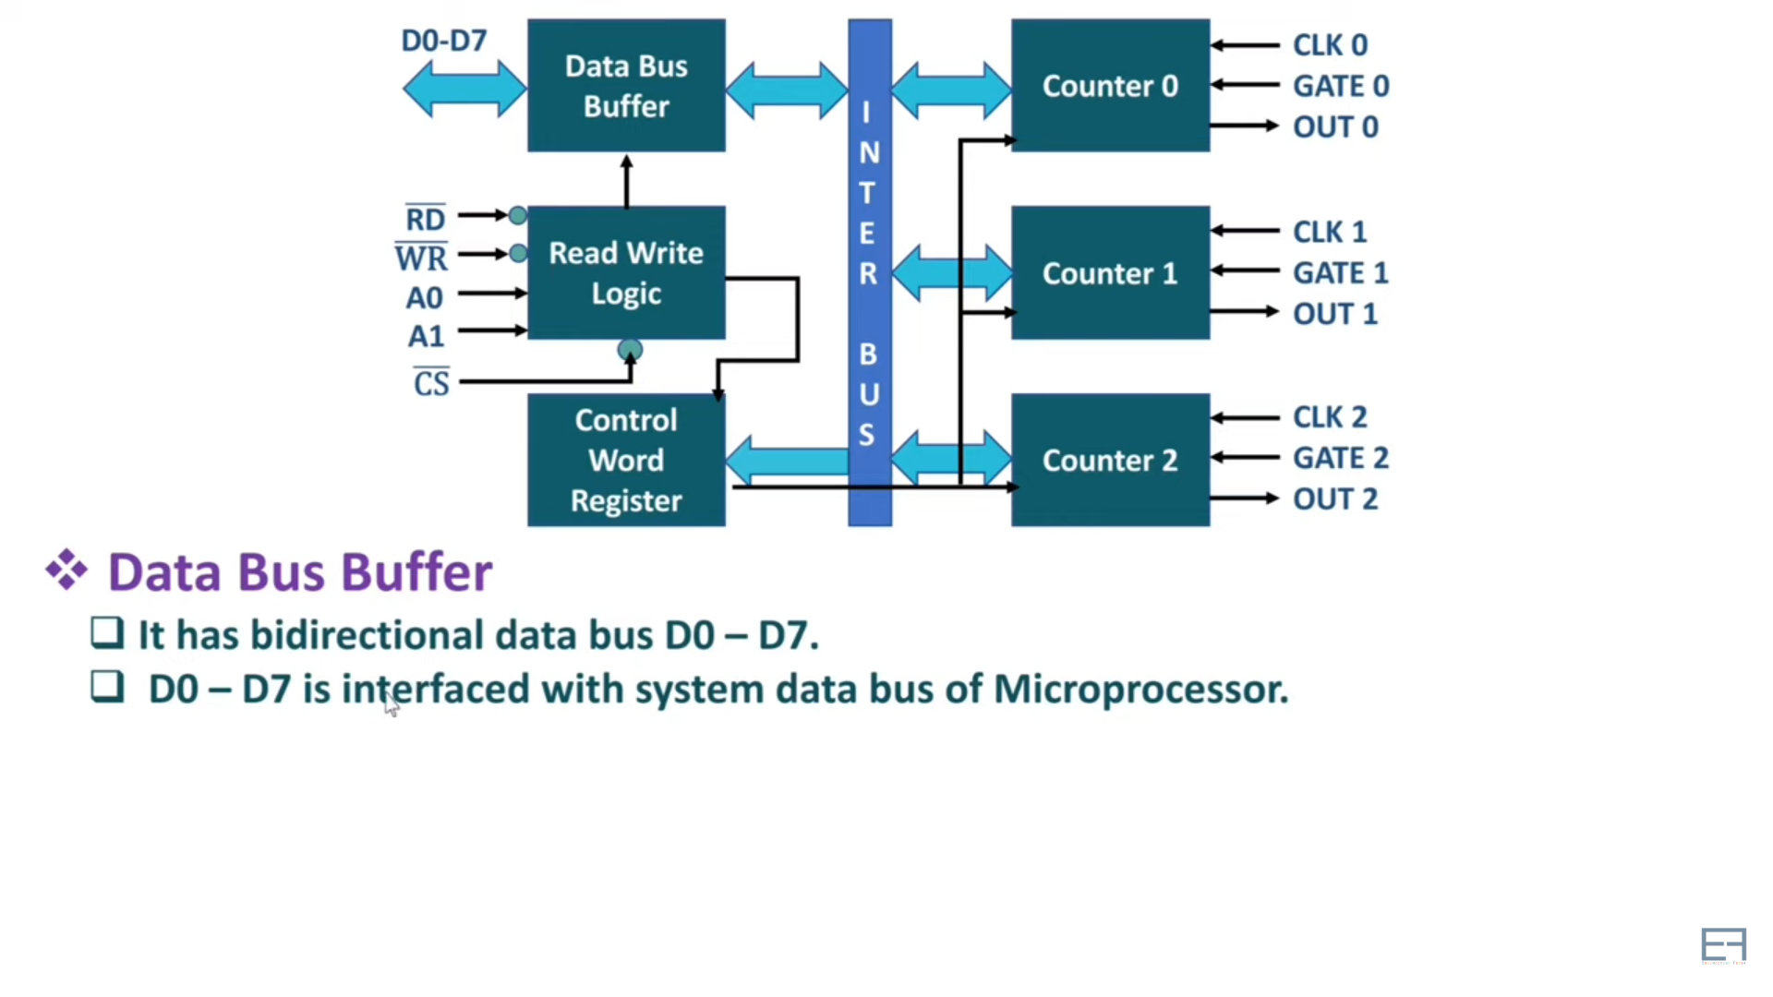
Block Diagram of 8253/54 Programmable Interval Timer

Slide 19
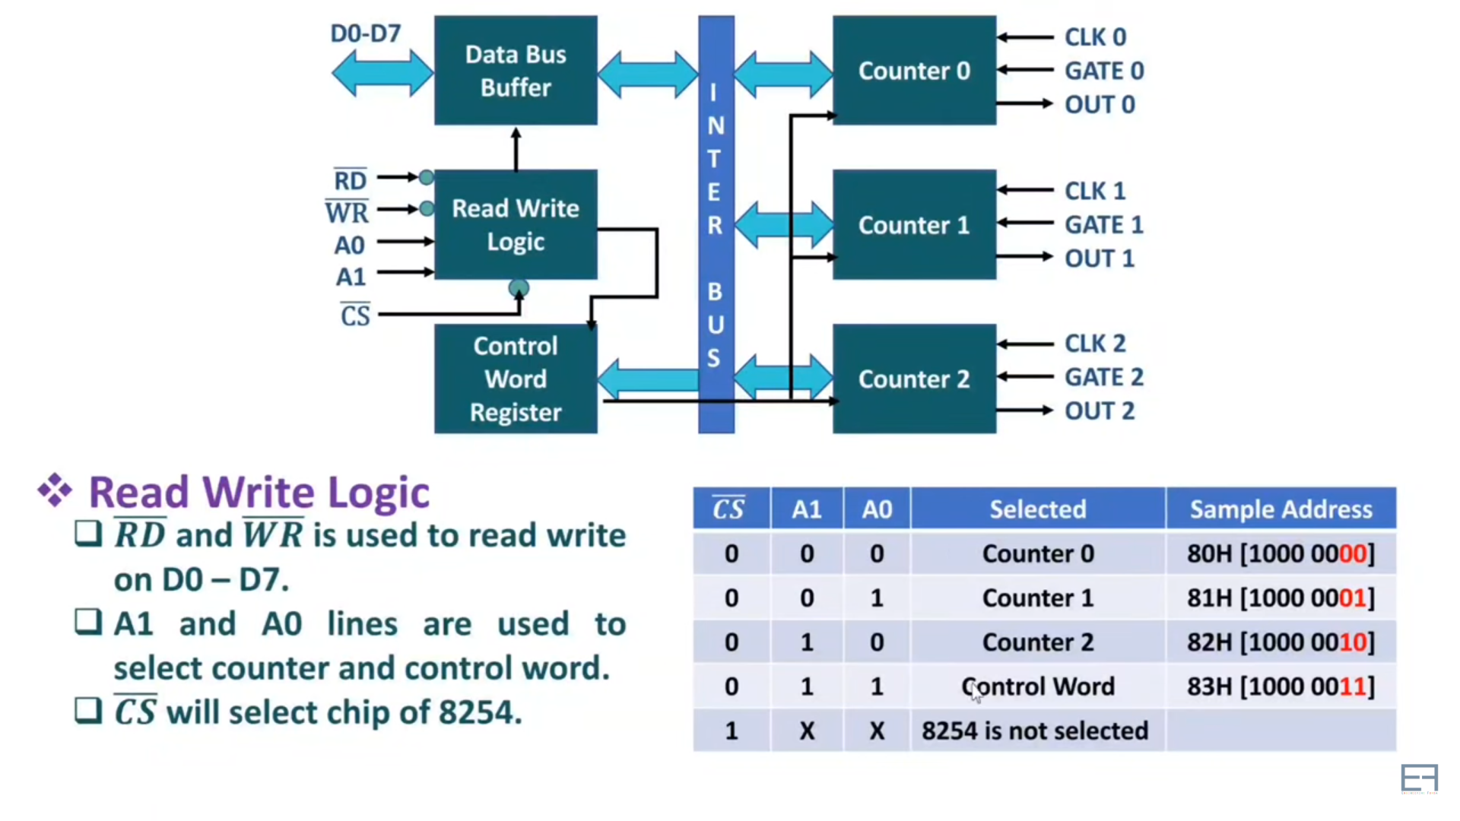
Read Write logic for 8254

Slide 20
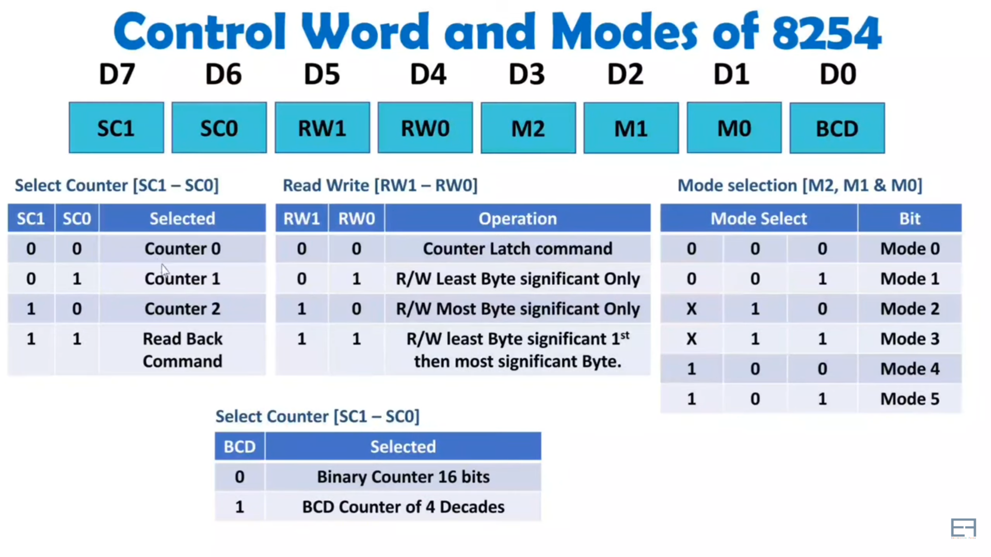

Slide 21
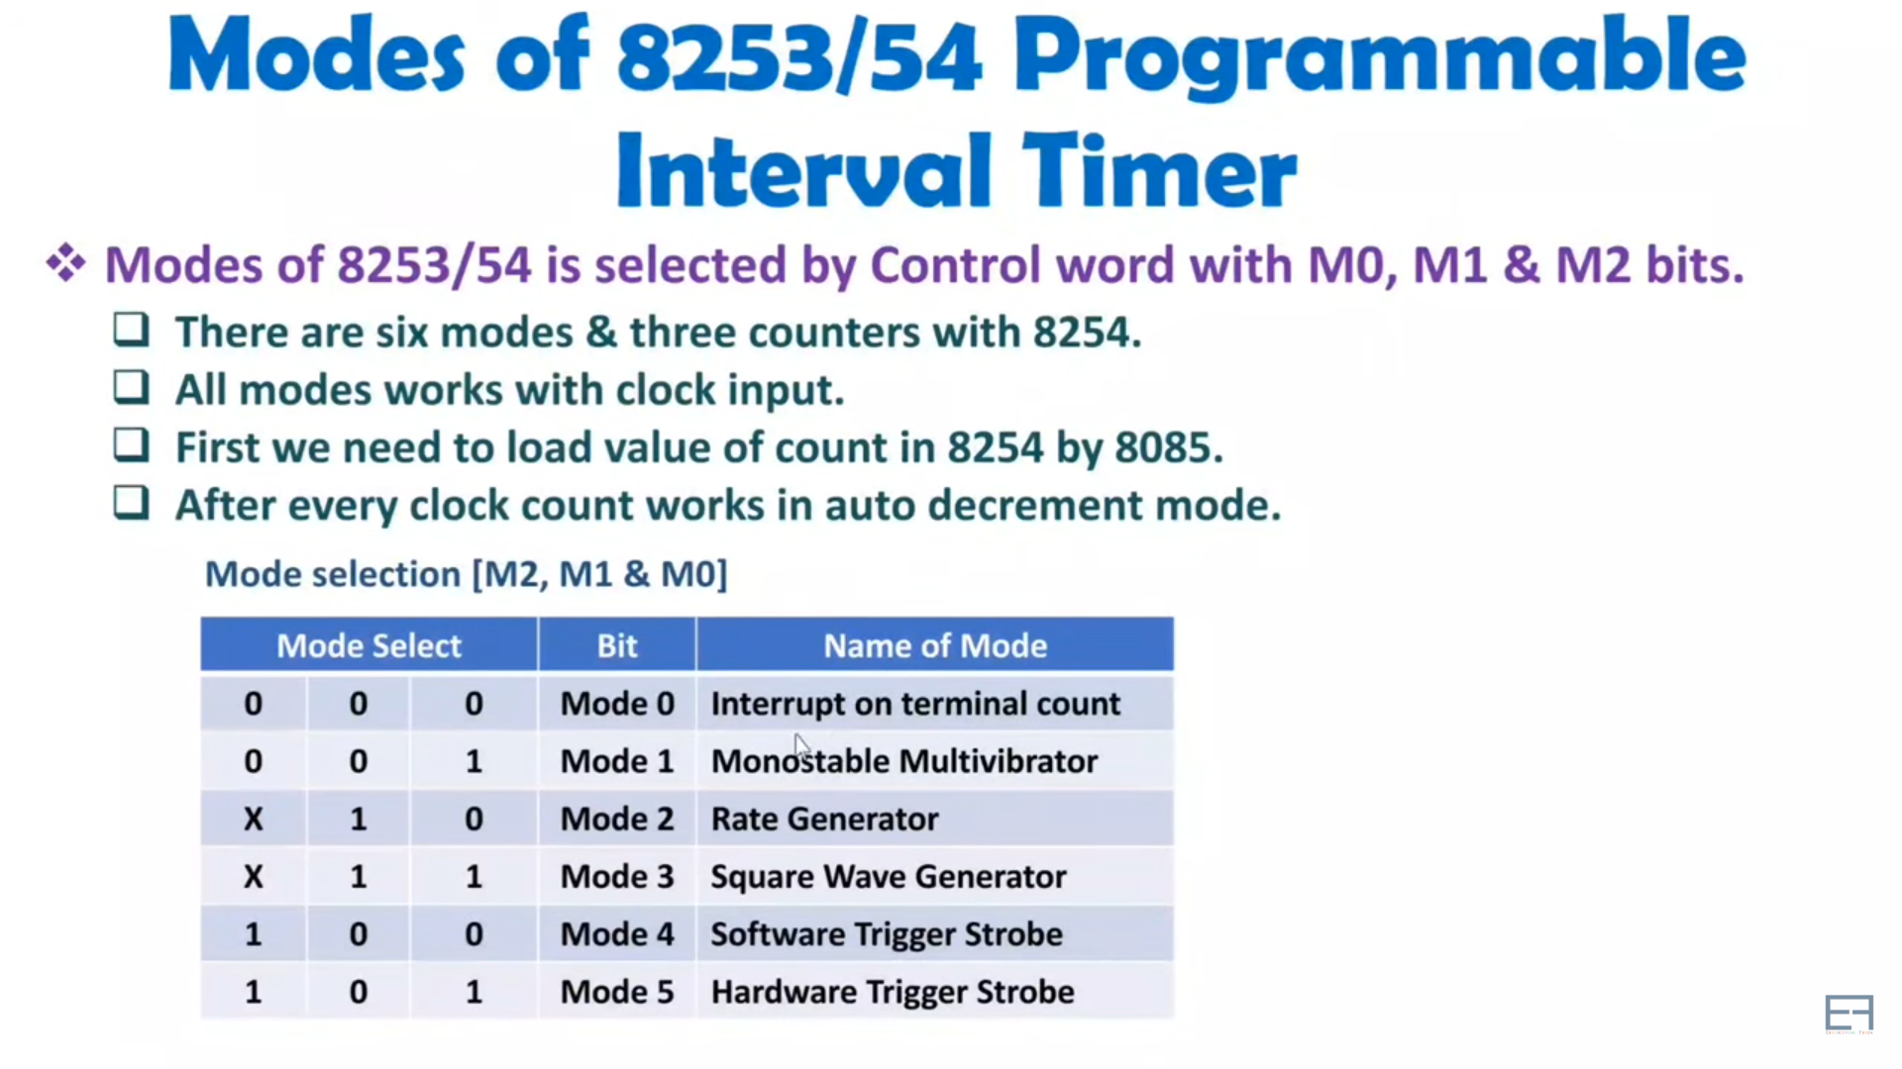

Slide 22
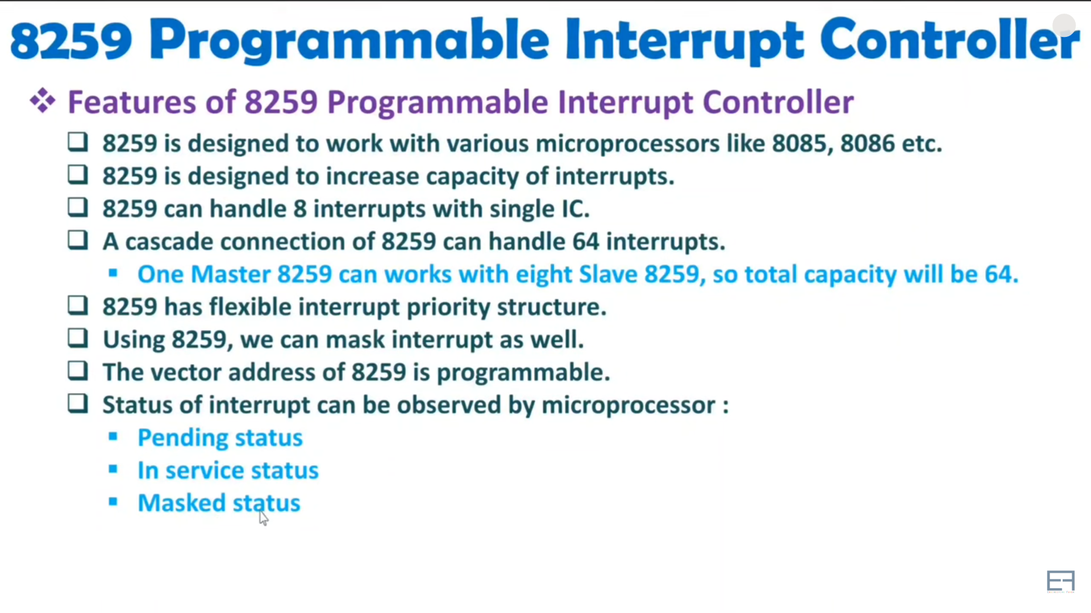

Slide 23
8259 Programmable Interrupt Controller
The 8259A is a programmable interrupt controller specially designed to work with Intel microprocessor 8080, 8085A, 8086, 8088.

Slide 24
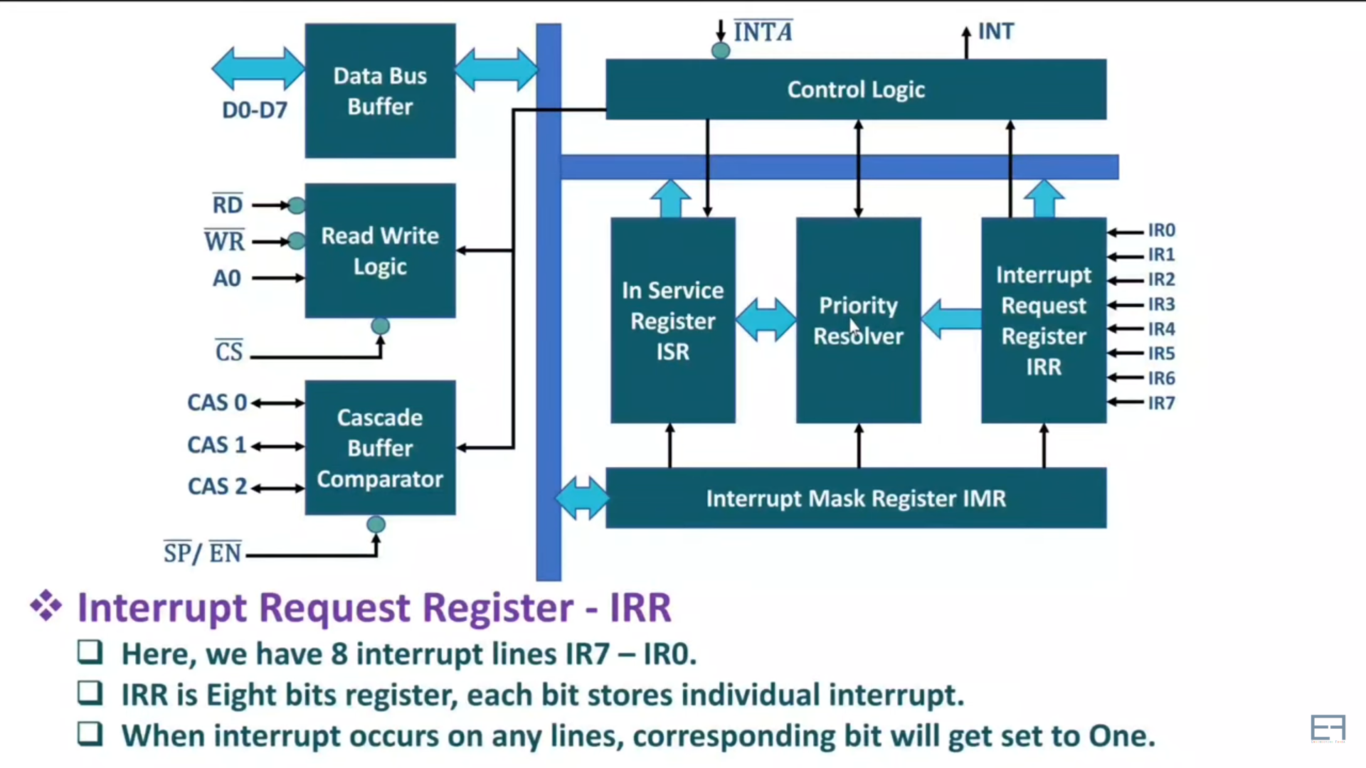
Block diagram of 8259

Slide 25
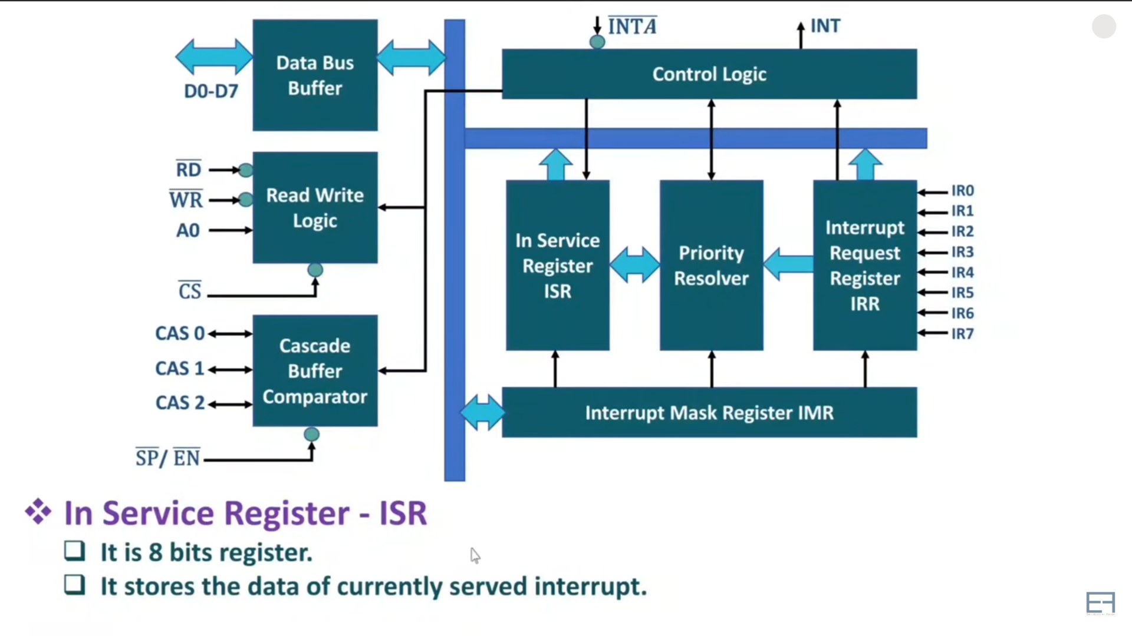
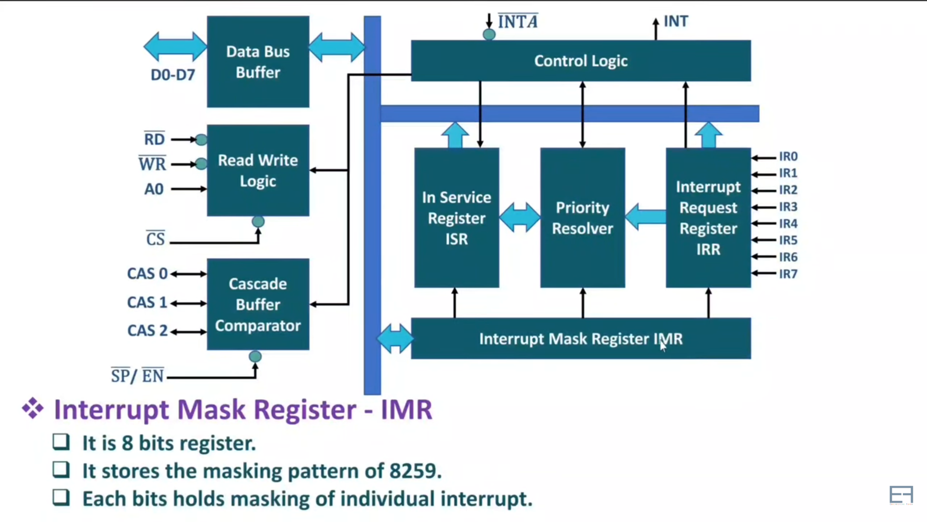
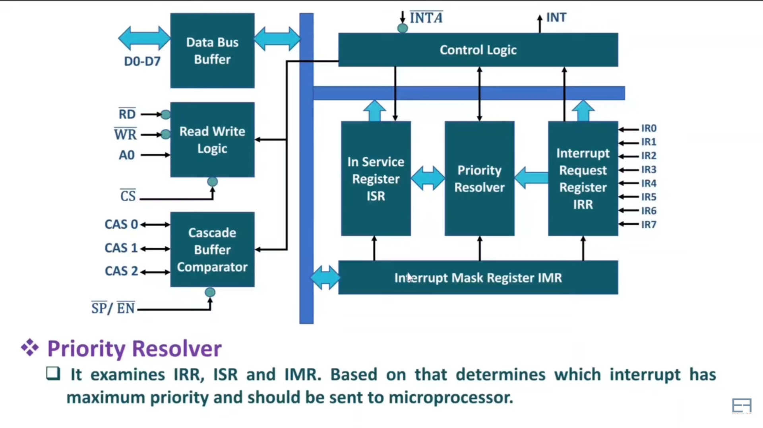
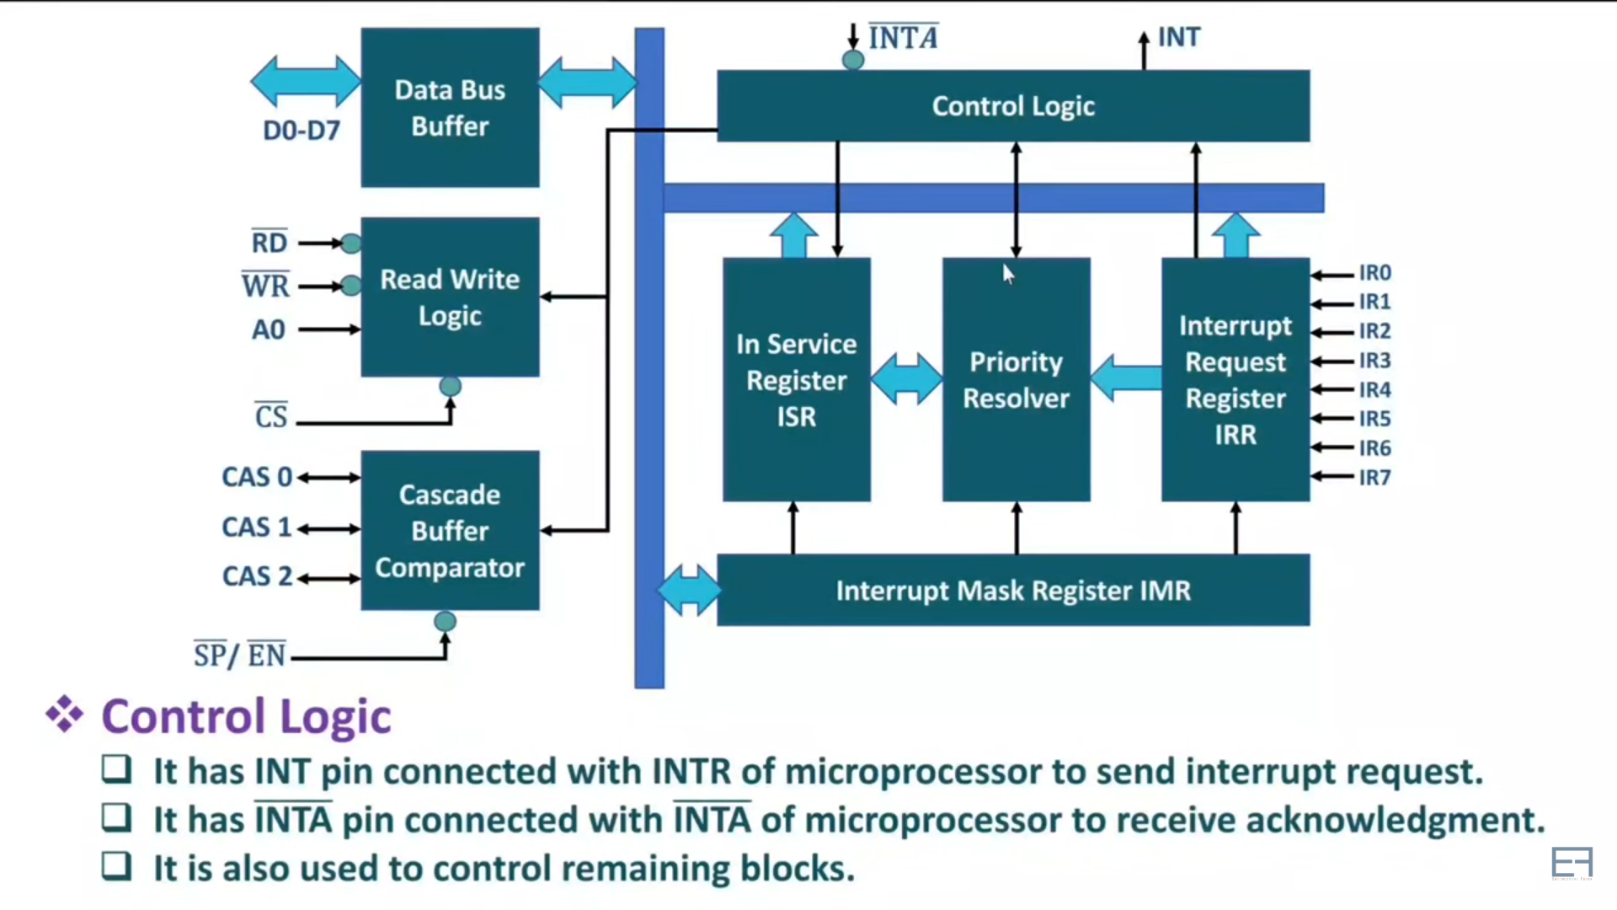
Block diagram of 8259

Slide 26
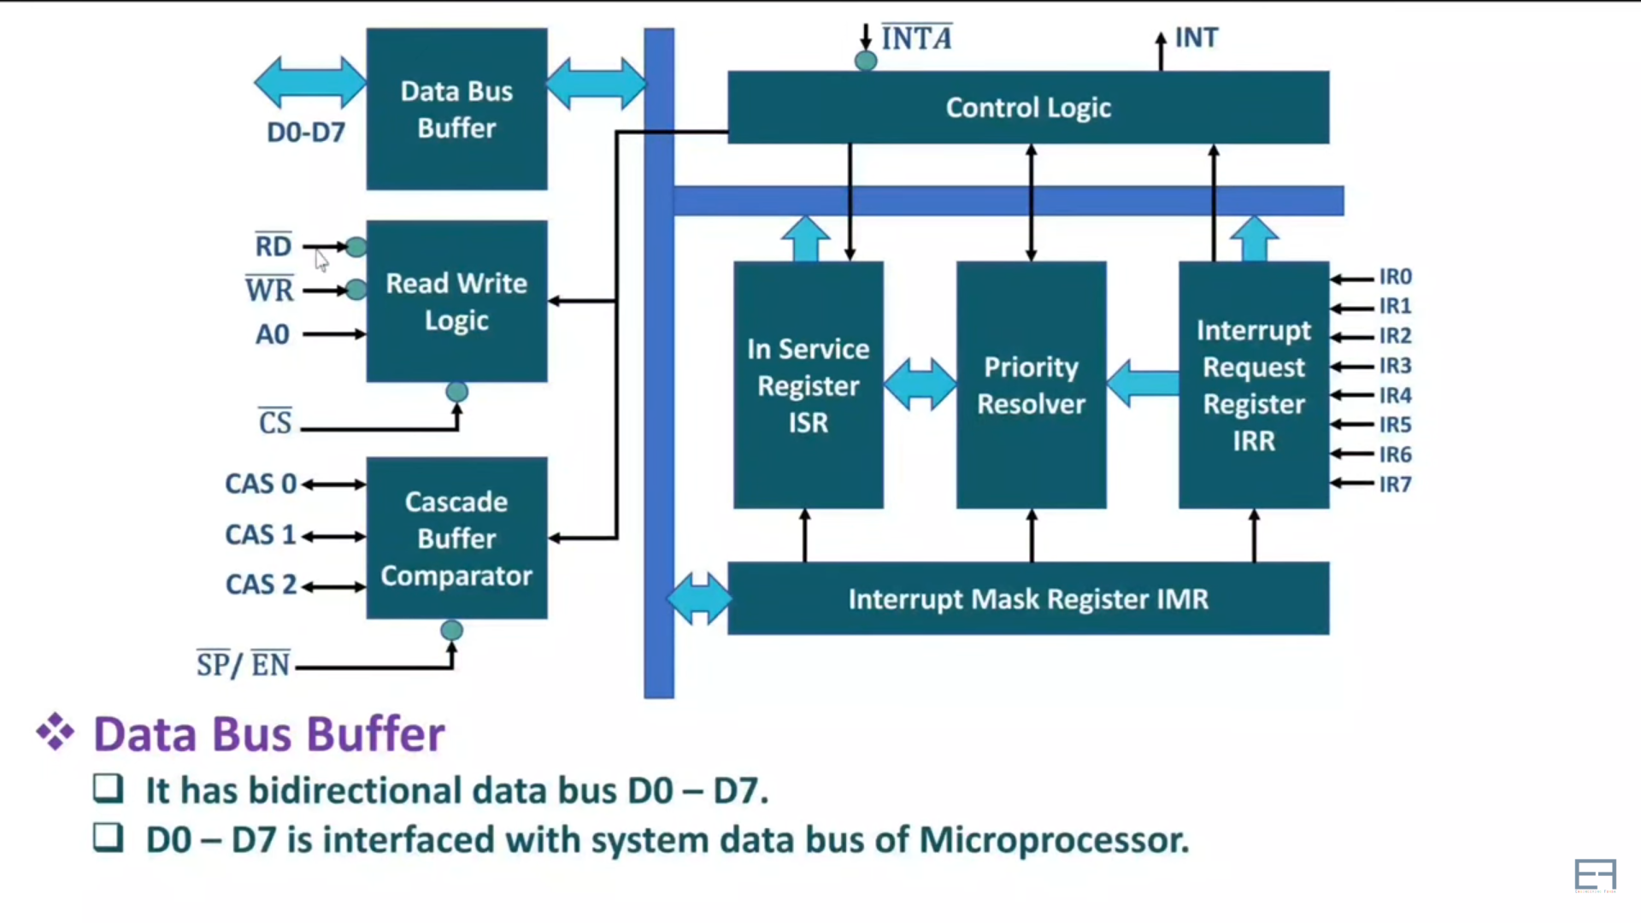
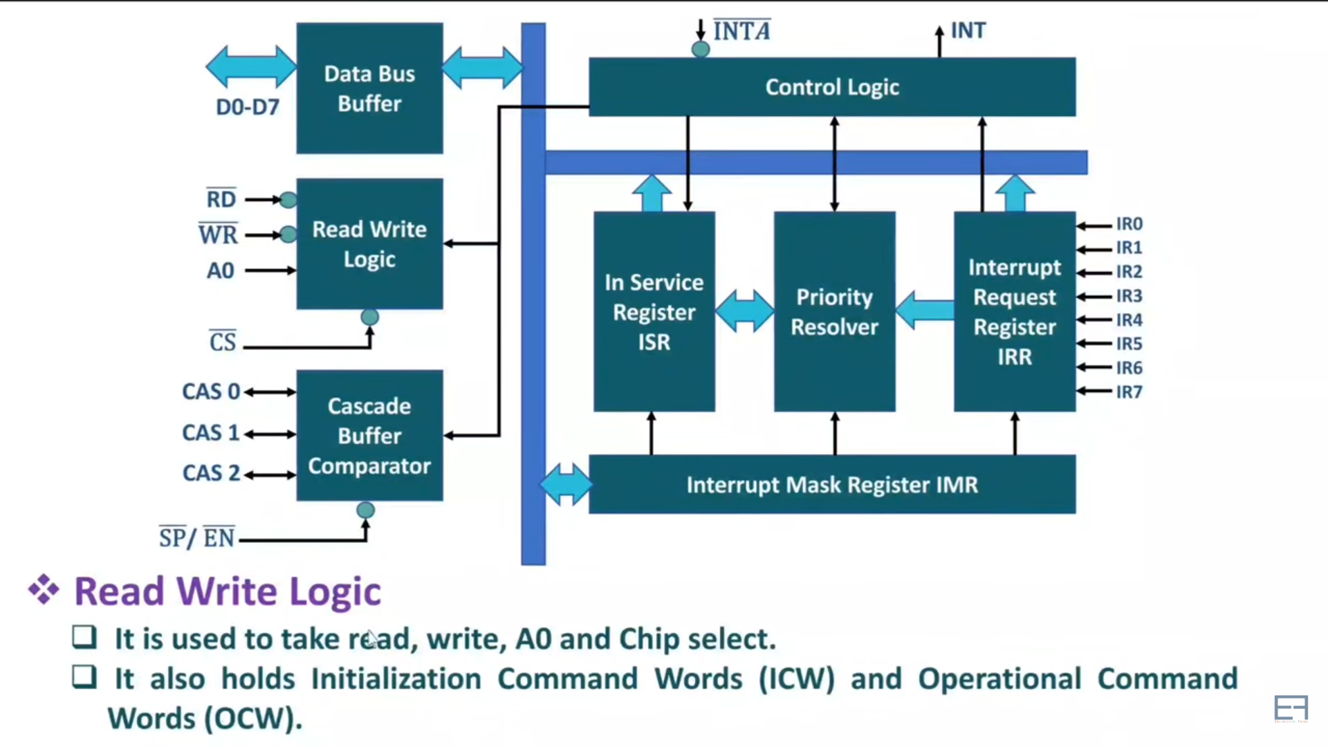
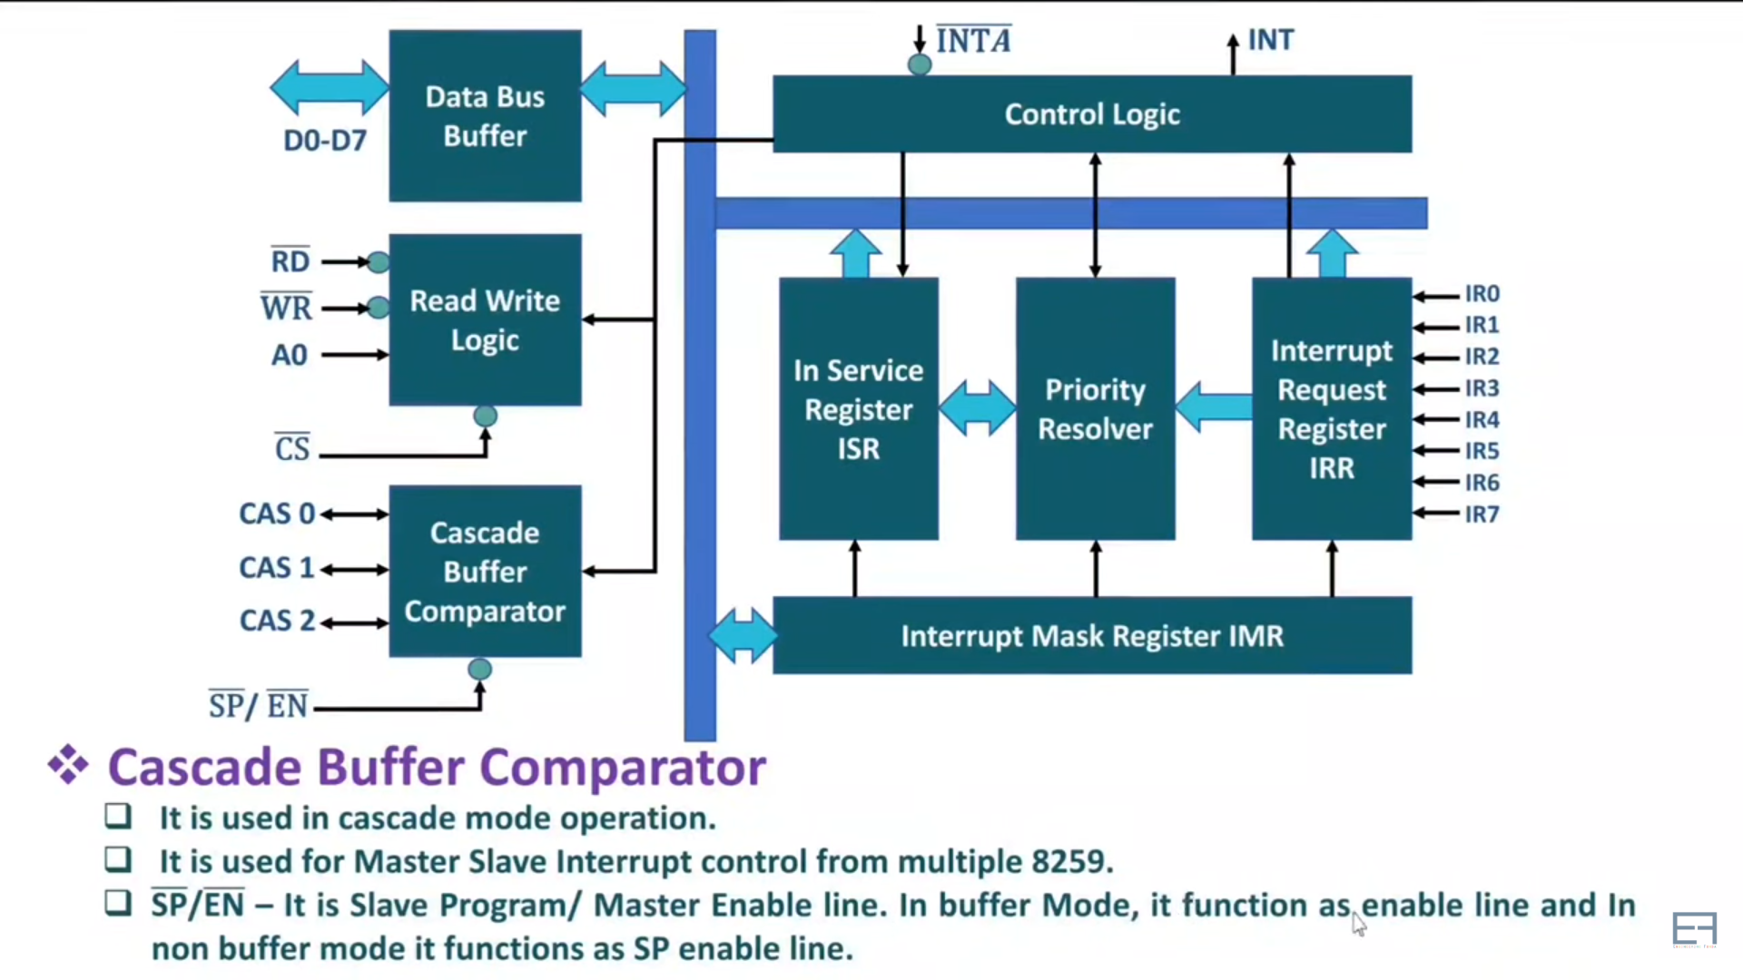
Block diagram of 8259

Slide 27
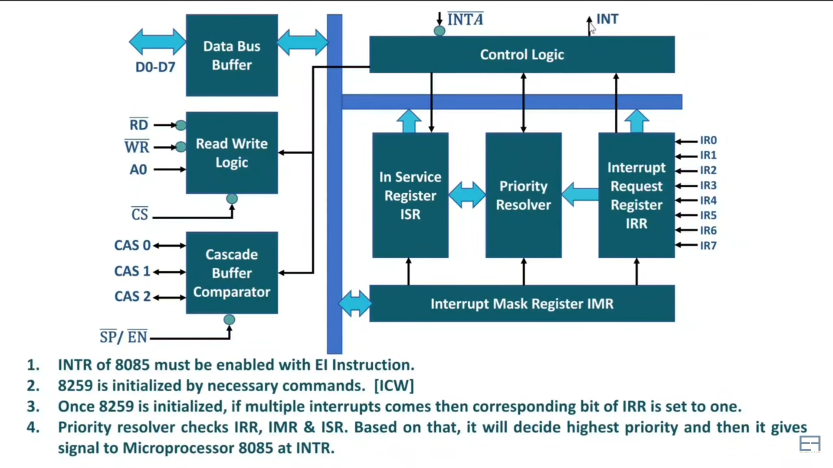
Working of 8259 PPI

Slide 28
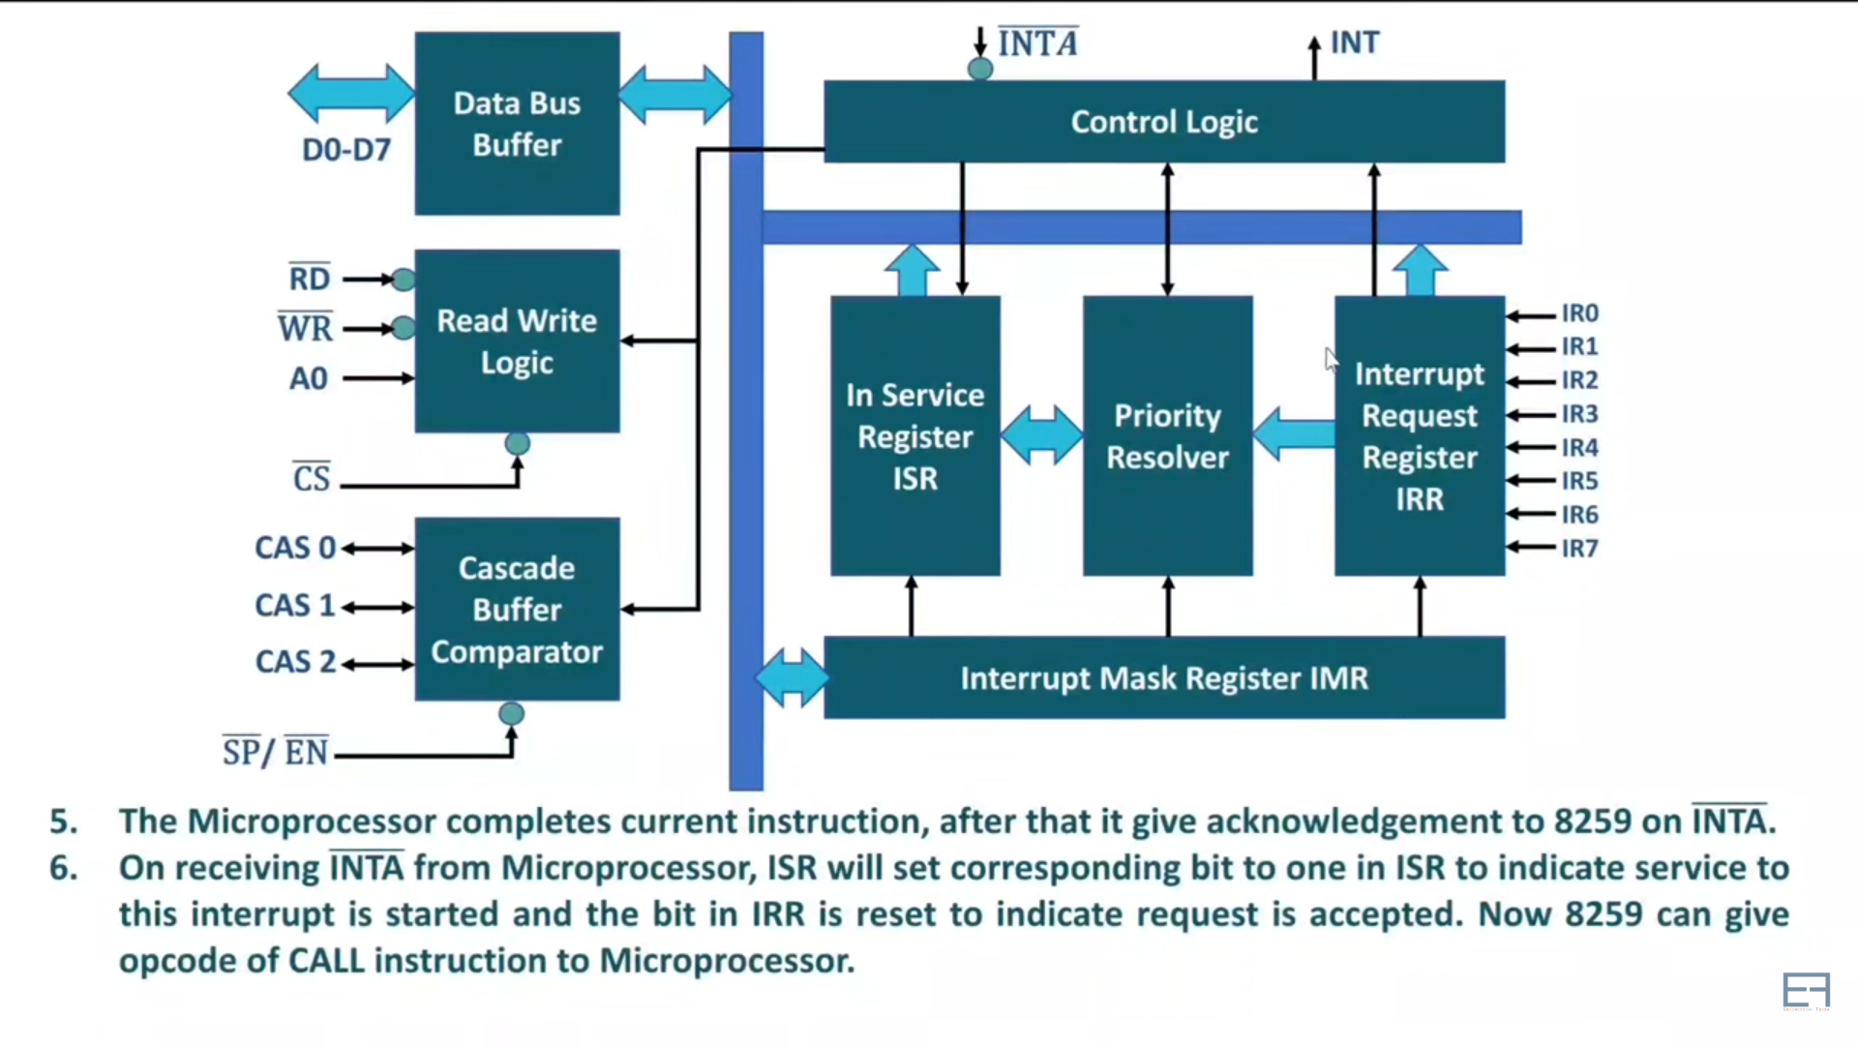
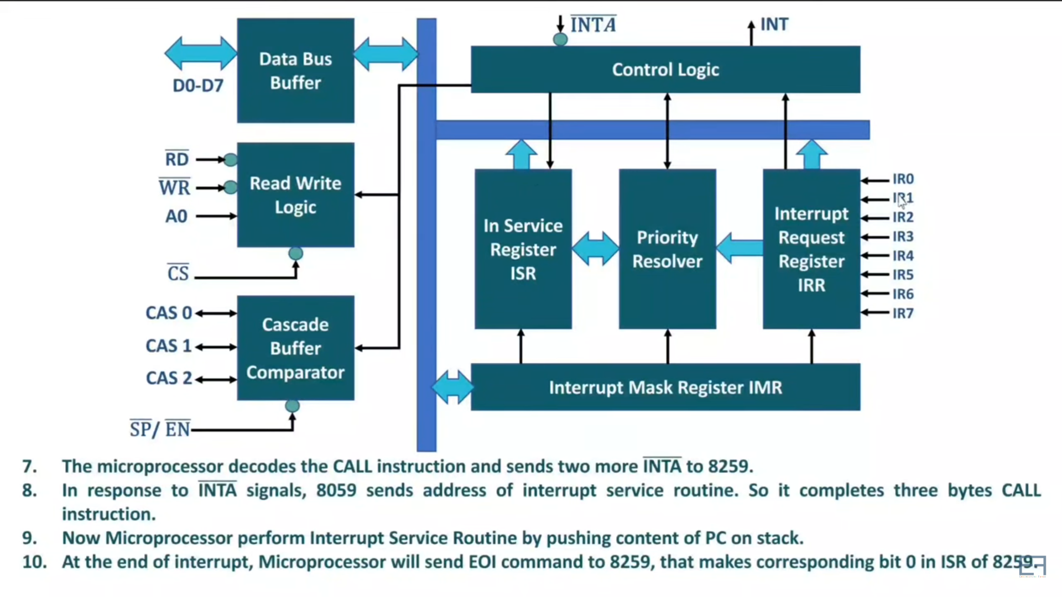
Working of 8259 PPI

Slide 29
8257 DMA Controller
2nd Machine Cycle
1st Machine Cycle
Memory
MPU
I/O
In typical process data transfer rate slow down. DMA’s roles is to bypass the microprocessor so that faster data exchanges happens between Memory and I/O

Slide 30
Basics 8257 DMA Controller
DMA stands for Direct Memory Access. It is designed by Intel to transfer data at the fastest rate. It allows the device to transfer the data directly to/from memory without any interference of the CPU.
Using a DMA controller, the device requests the CPU to hold its data, address and control bus, so the device is free to transfer data directly to/from the memory. The DMA data transfer is initiated only after receiving HLDA signal from the CPU.

Slide 31
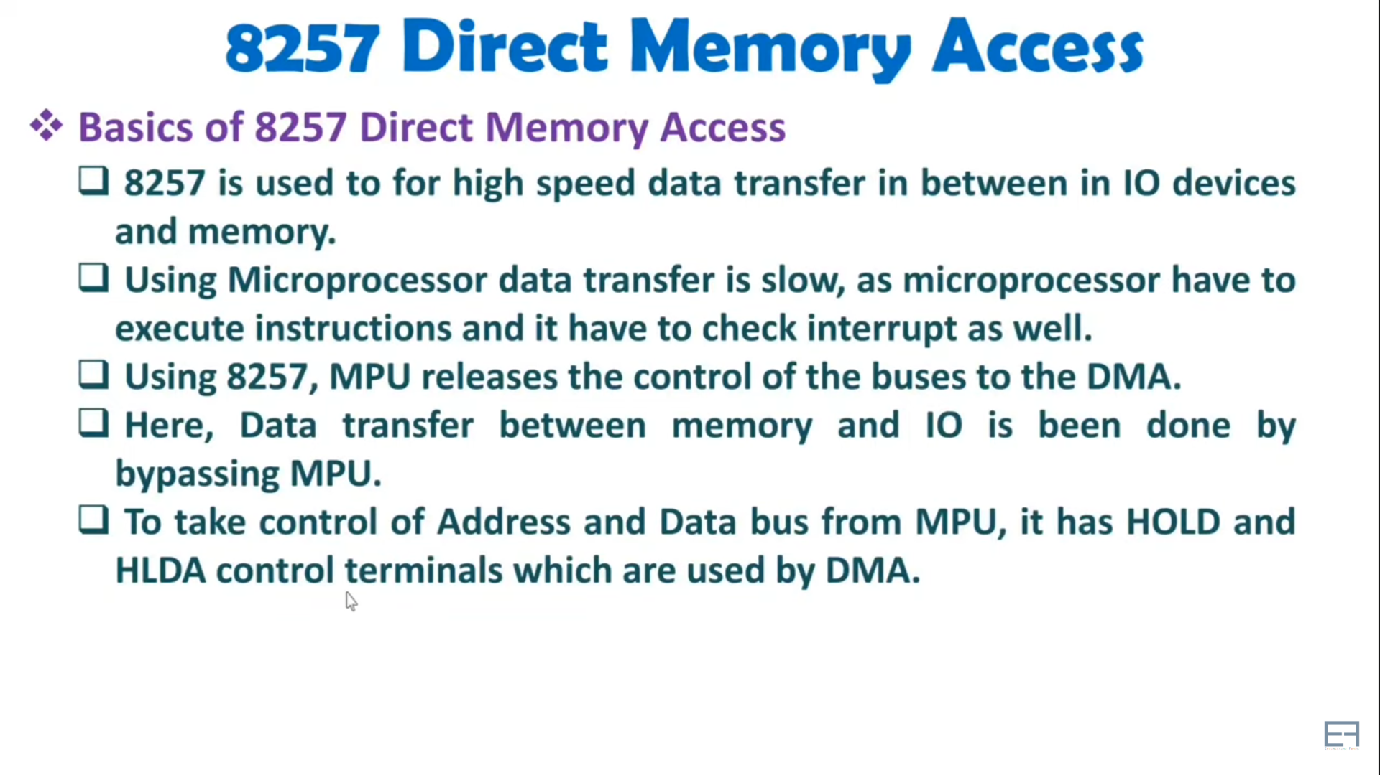

Slide 32
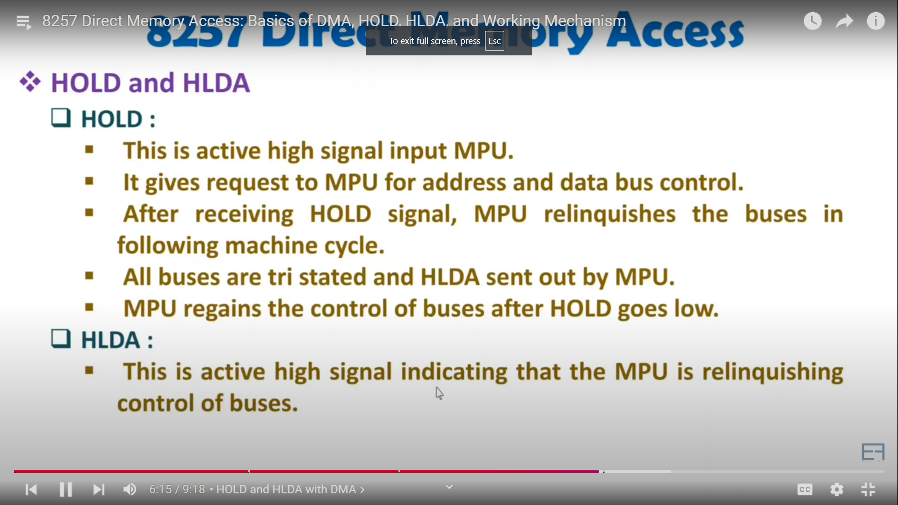
HLD & HLDA of 8257

Slide 33
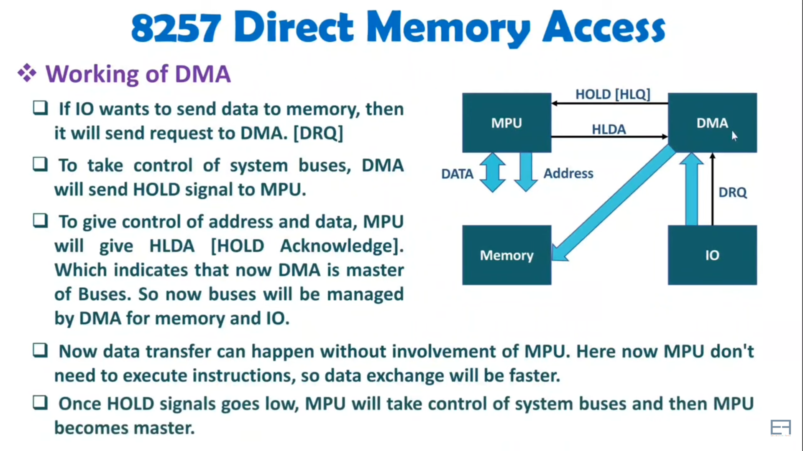
Working of 8257

Slide 34
Features of 8257
It has four channels which can be used over four I/O devices.
Each channel has 16-bit address and 14-bit counter.
Each channel can transfer data up to 64kb.
Each channel can be programmed independently.
Each channel can perform read transfer, write transfer and verify transfer operations.
It generates MARK signal to the peripheral device that 128 bytes have been transferred.
It requires a single phase clock.
Its frequency ranges from 250Hz to 3MHz.
It operates in 2 modes, i.e., Master mode and Slave mode.

Slide 35
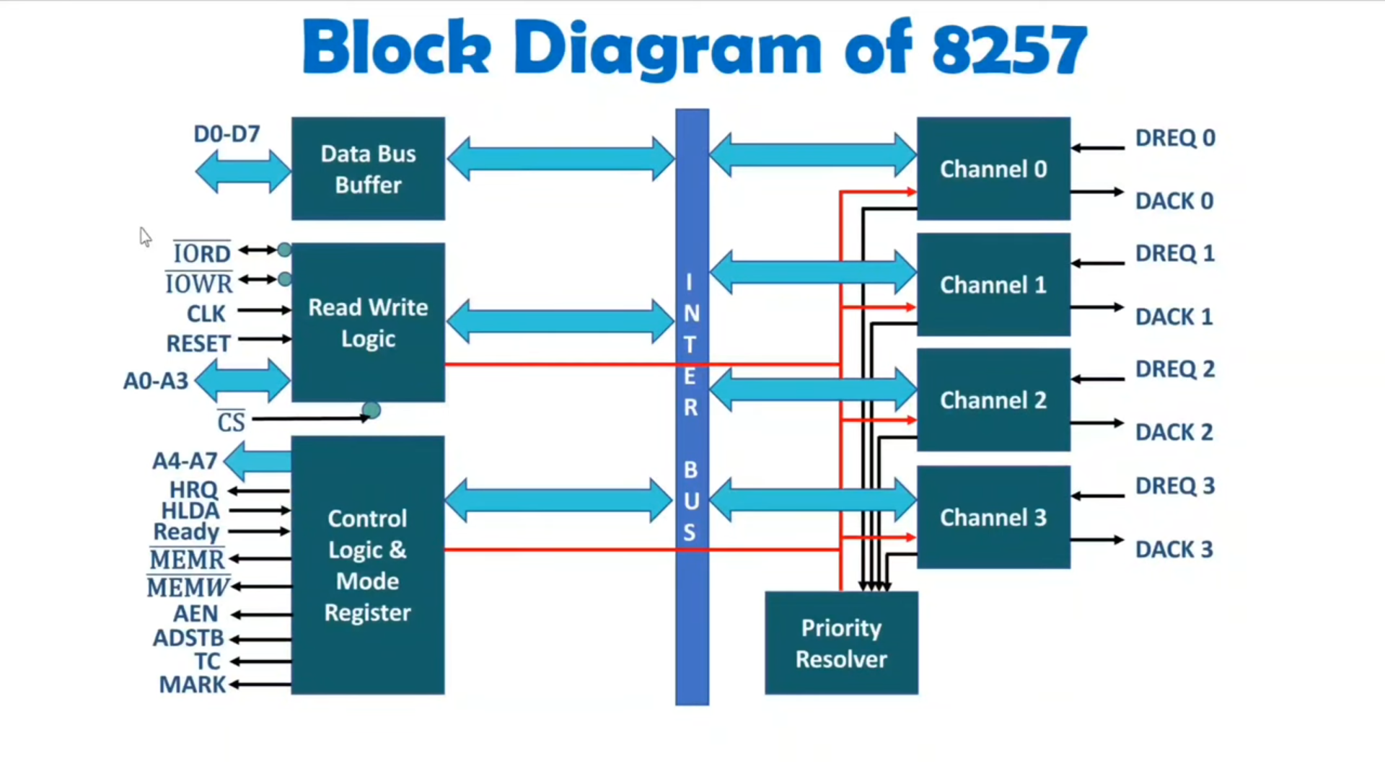

Slide 36
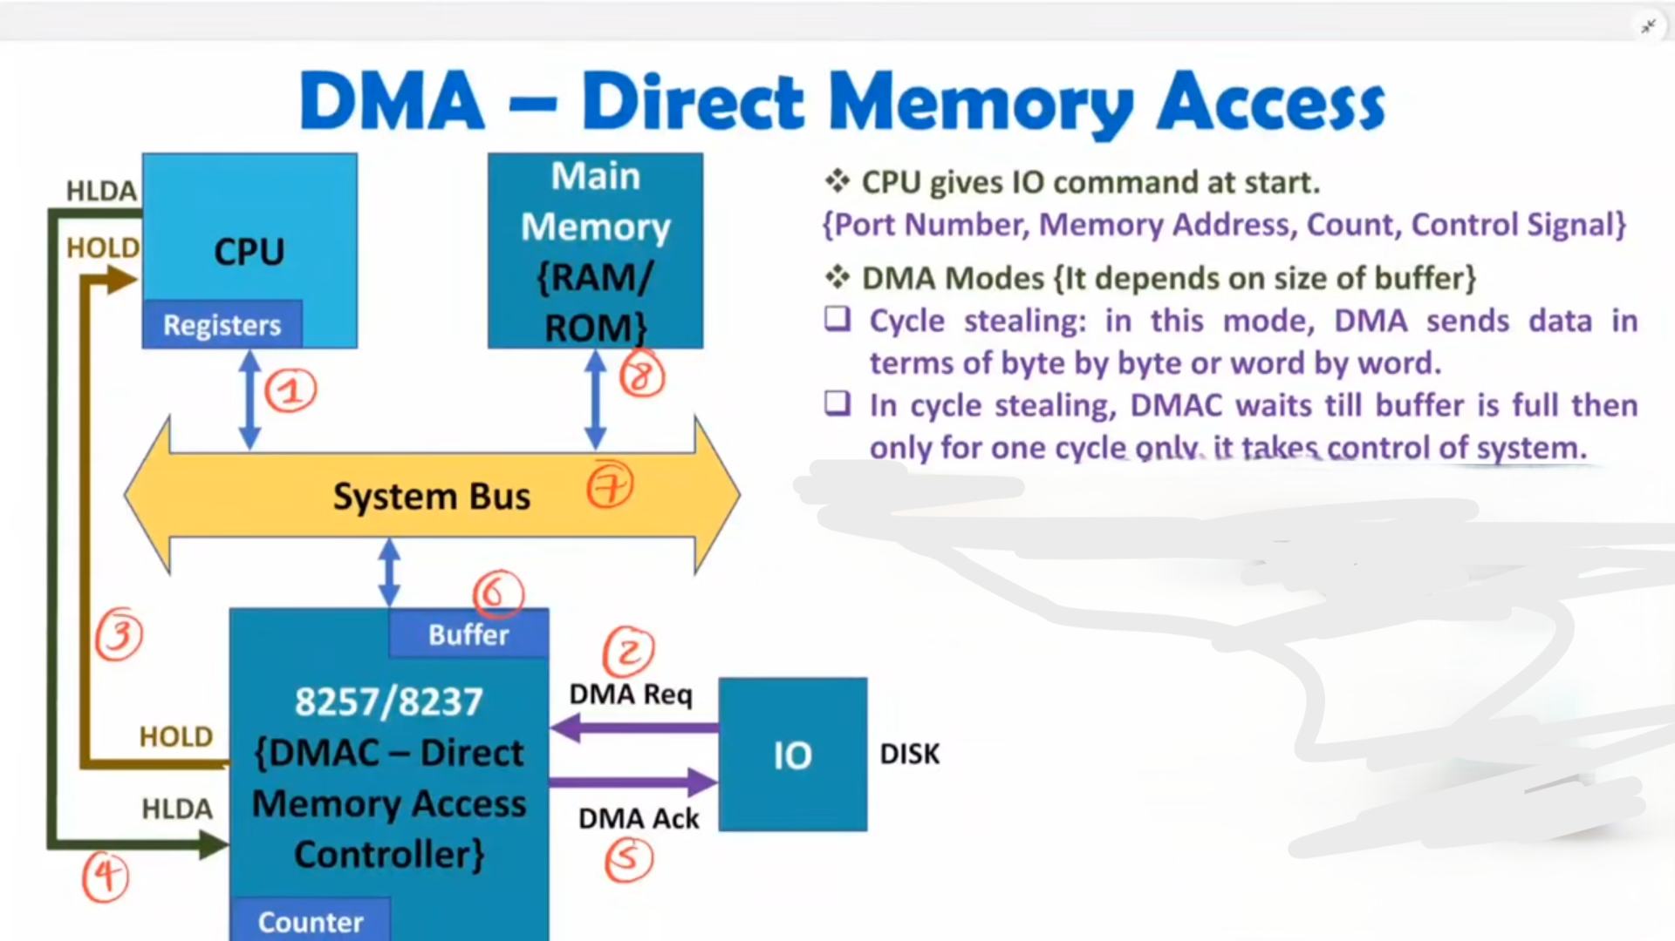
Burst / Batch Mode: In this mode DMA sends data in bulk. Here size of buffer is large
* In Burst mode once DMAC buffer is full, it takes control of system bus for data transfer.

